Slide 1




Investigations of Precipitation Partitioning
Between Arizona and New Mexico
During the North American Monsoon
Cynthia R. Kobold
Department of Applied Aviation Sciences
Embry-Riddle Aeronautical University, Prescott, Arizona

Slide 2
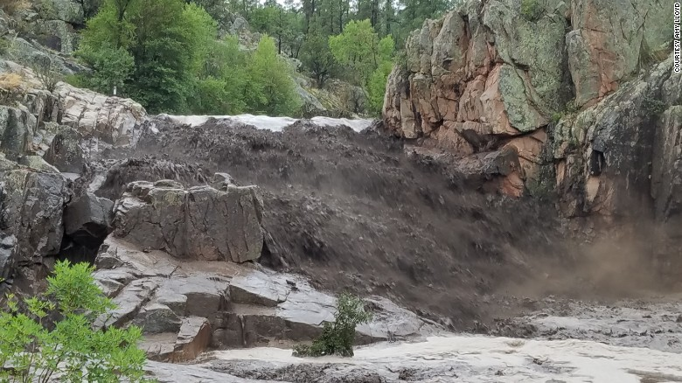
Motivation
Effects of flooding:
  Loss of life
  Loss of property
  Environmental Hazards
July 2017 Arizona:
  Heavy rain fell 8 miles upstream on a burn scar
  Family of 10 killed in Payson swimming hole
  Deaths included five children ages 2 to 13
Photo credit: ABC 15 Arizona

Slide 3
Research Objectives
The goal is to understand the see-saw between Arizona (AZ) and New Mexico (NM) precipitation during the North American Monsoon (NAM).
  Why is it sometimes wet in AZ and dry in NM and vice-versa?
  Can we differentiate between summer monsoon precipitation over AZ and NM by identifying moisture sources and climate linkages?
  This would enable better forecasts of precipitation over AZ & NM

Slide 4
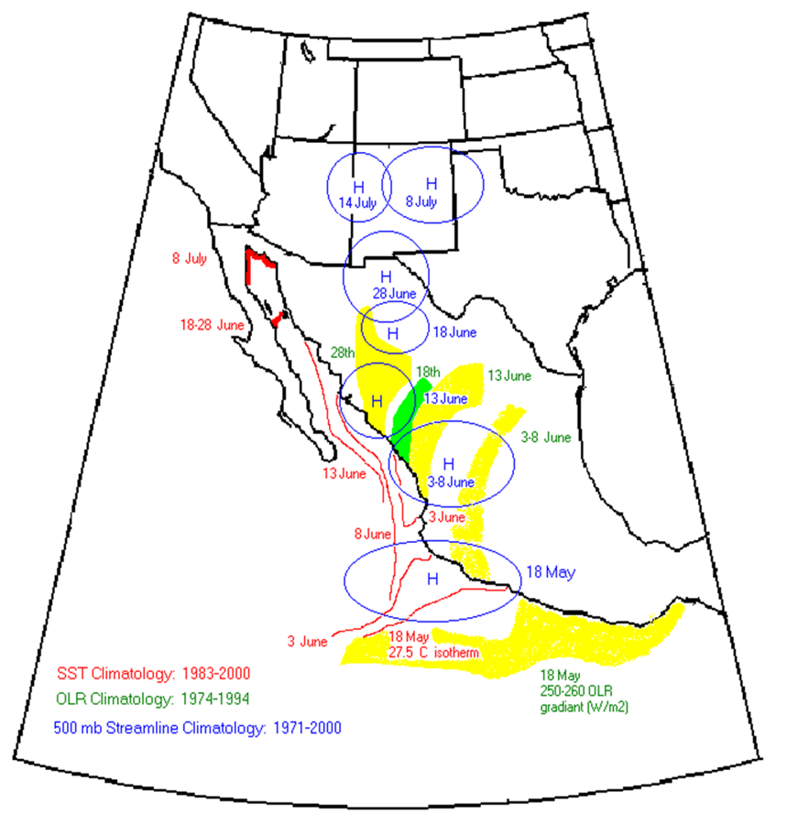
NAM Overview
Northward progression of high pressure during early summer
High pressure propagates northward until it reaches the Four Corners area
Sea surface temperatures (SSTs) increase along the Gulf of California (GOC) and Eastern Pacific
Seasonal reversal of winds
Responsible for ~40% of SW U.S. annual rainfall
July
Late June
Mid June
Early June
May

Slide 5
Methodology
Meteorological Analysis & Diagnosis Software (MADS)
  Data and graphics software for the Meteorology Program at Embry-Riddle Aeronautical University, Prescott
  Ability to produce maps, cross & time-sections, vertical profiles and soundings
Access to NOAA archives from 1948 - present

Slide 6
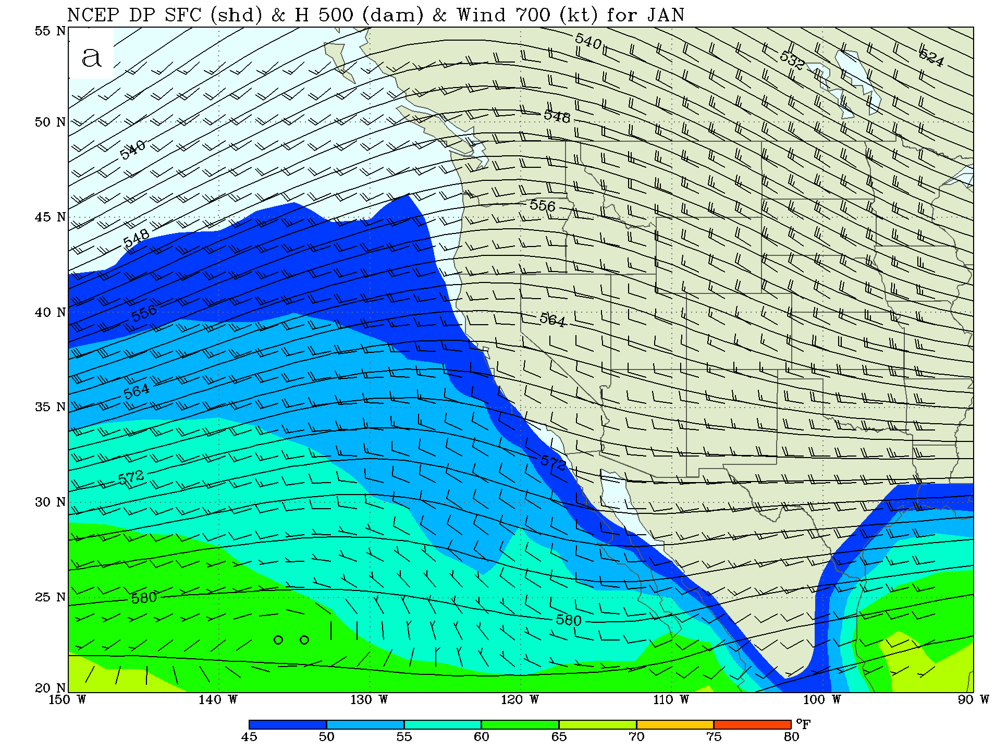
Winter Flow
Westerly flow over entire region
Higher dewpoints over Pacific and Gulf, drier inland
40% of the annual precipitation is from the Pacific in winter
Shaded contours are dew point (moisture)

Slide 7
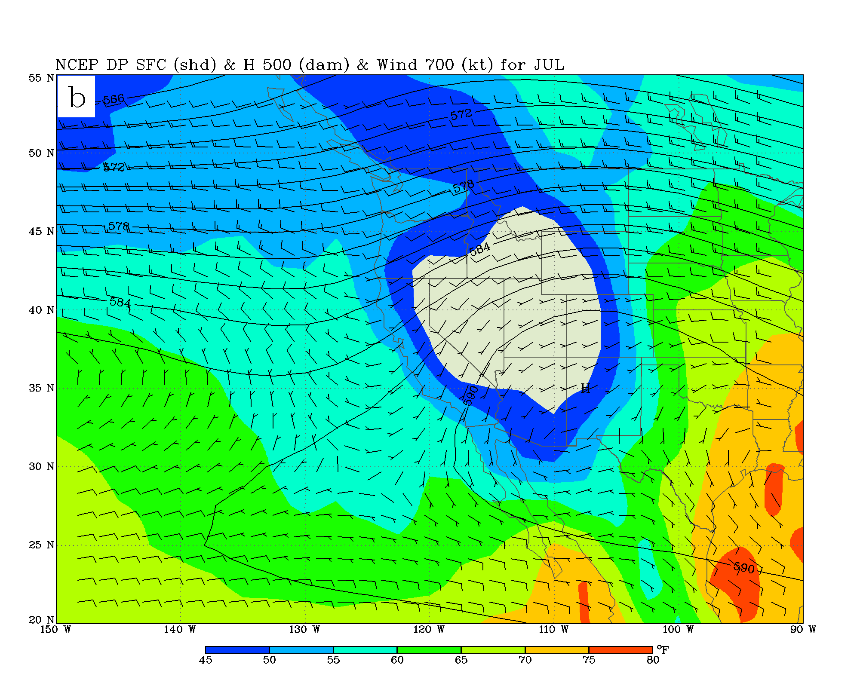
Summer Flow
Over AZ and western NM, SSW flow from GOC
Over eastern NM, SSE flow from Gulf of Mexico (GOM)
Different moisture sources for AZ vs NM
Higher dewpoints over CONUS and the SW than in winter

Slide 8
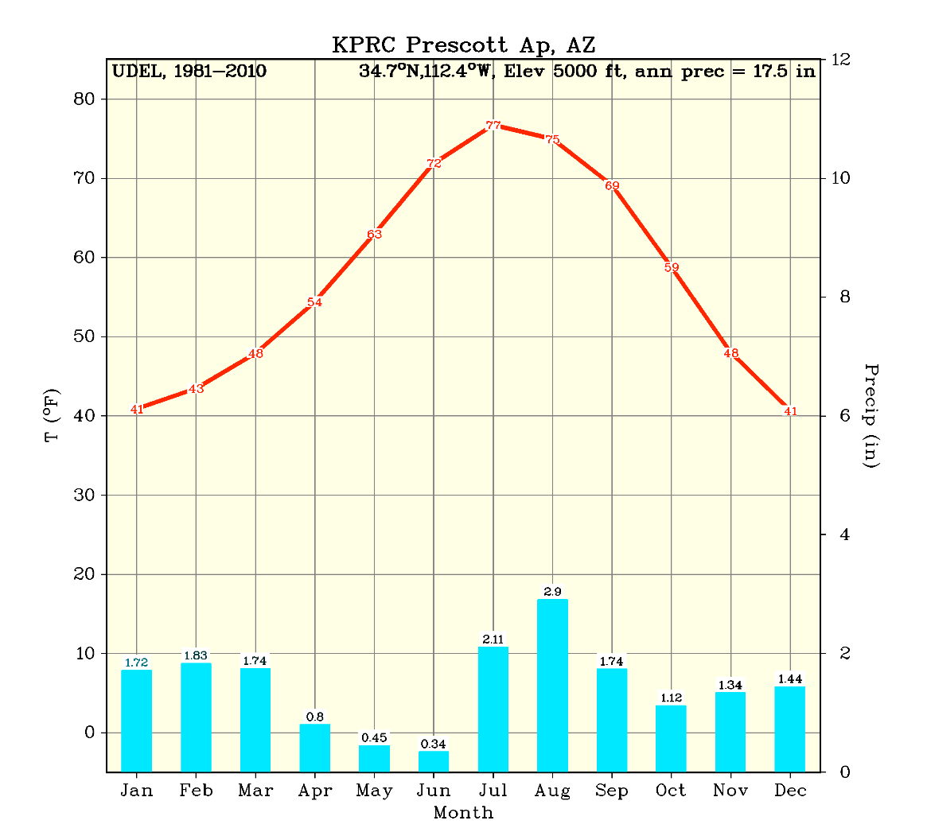
AZ/W-NM Climograph
Winter precipitation from Pacific storms
Tapers off in spring when dry air dominates
Intensifies over summer with advection of moisture from GOC
Two distinct precip regimes
Winter storms from the Pacific
Summer monsoon

Slide 9
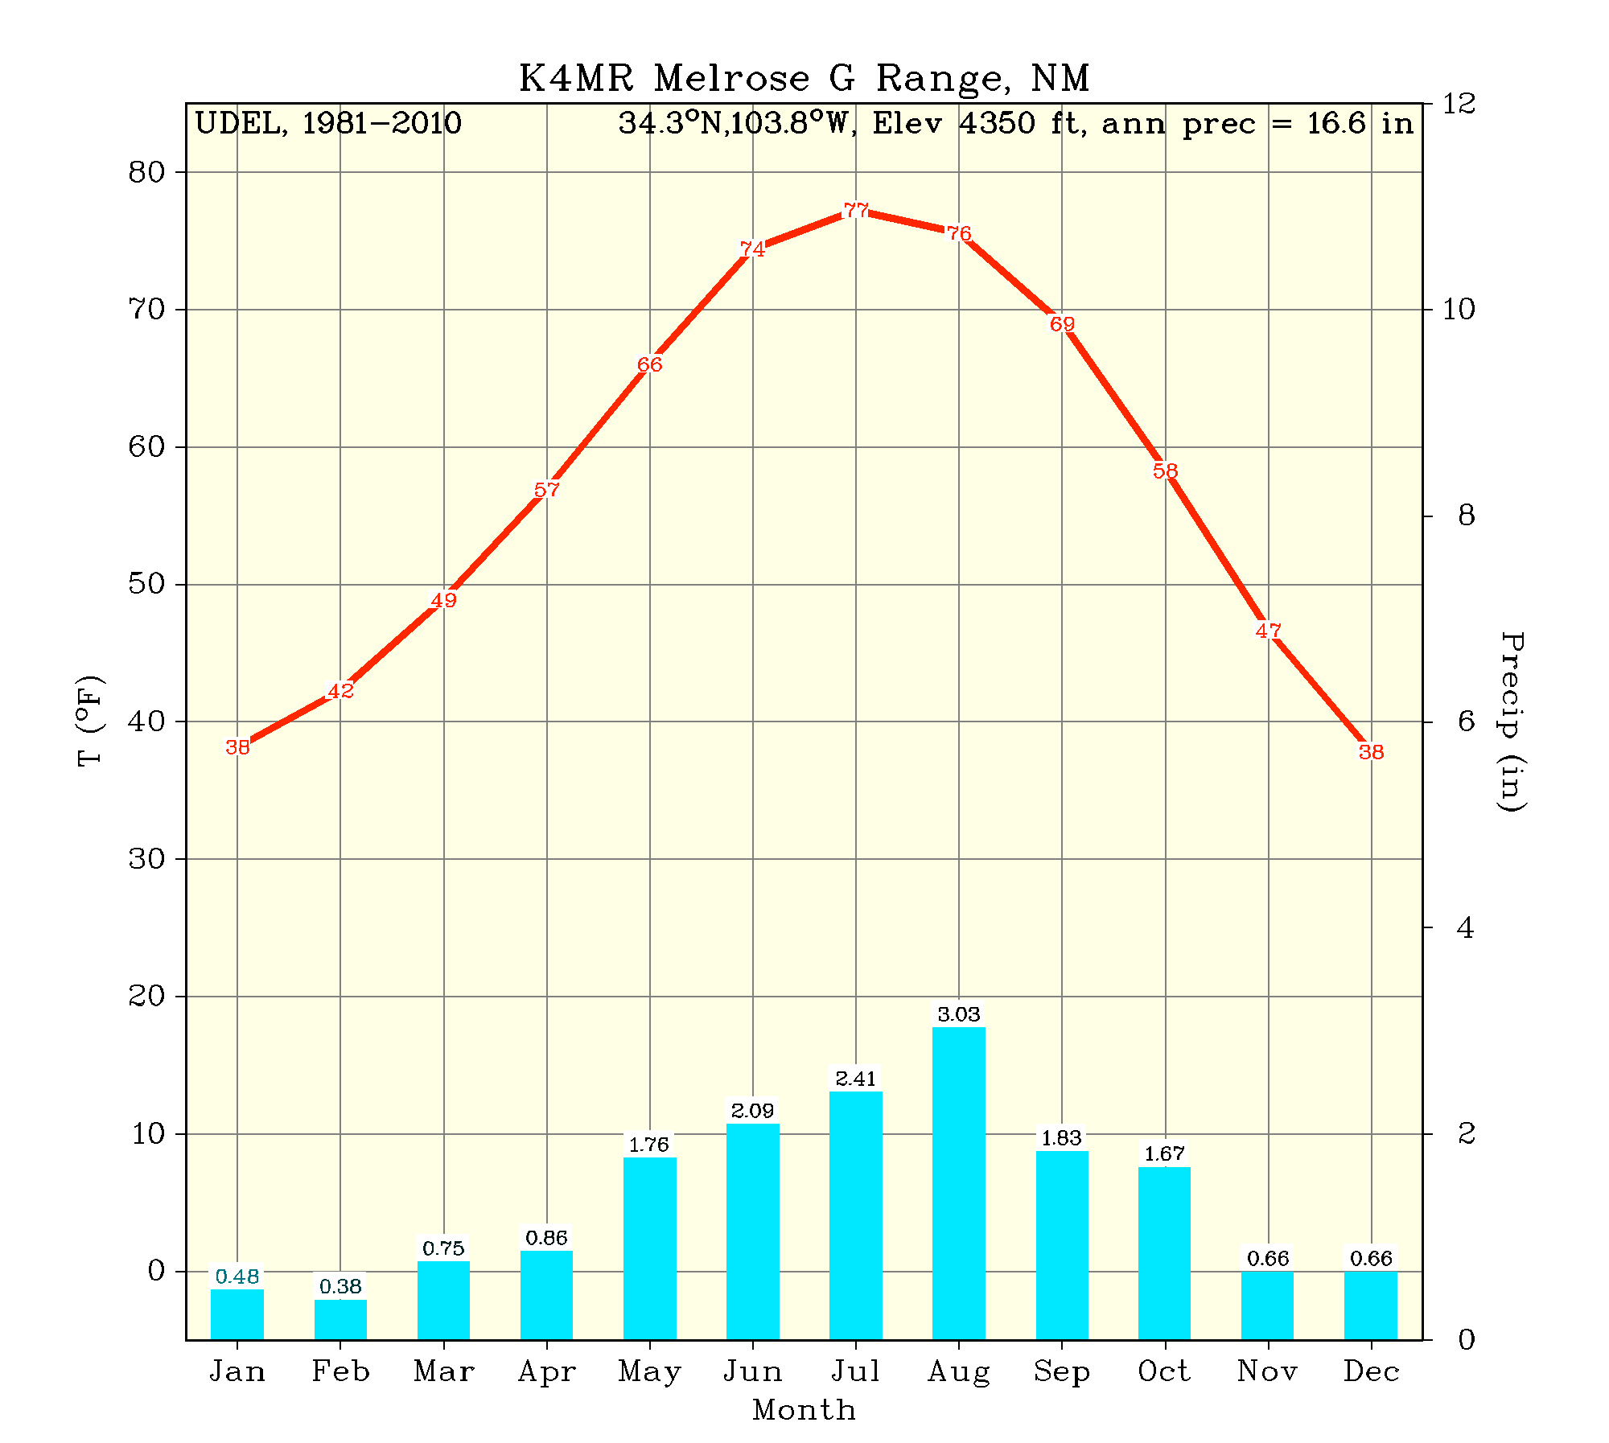
E-NM Climograph
Single August precipitation maximum
  Quite different from the two AZ precip seasons
Suggests different moisture sources & circulation patterns

Slide 10
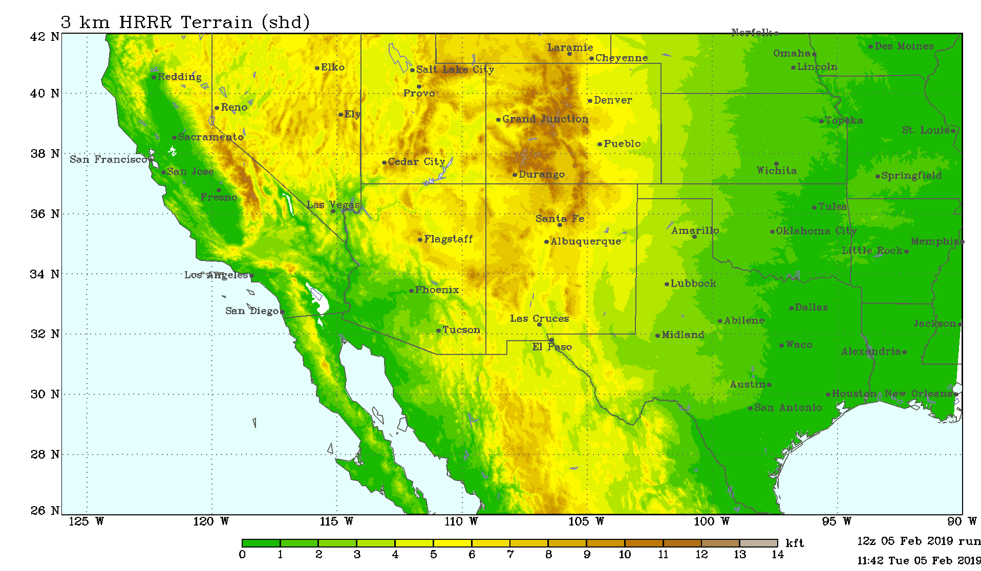
Moisture is blocked by NM mountain ranges
  GOC moisture is blocked from reaching NM
  GOM moisture is blocked from reaching AZ
Sangre de Cristo
San Andres
Sacramento
Summer flow

Slide 11
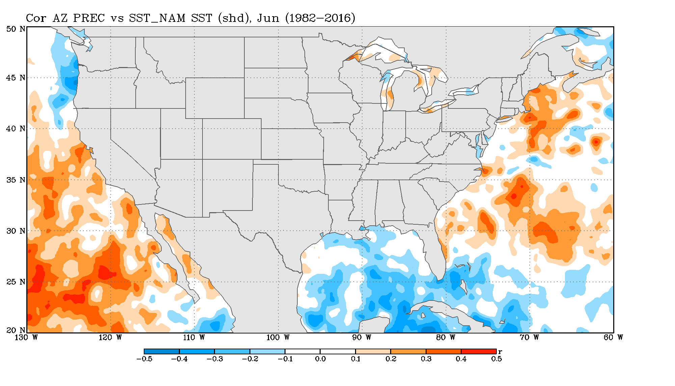
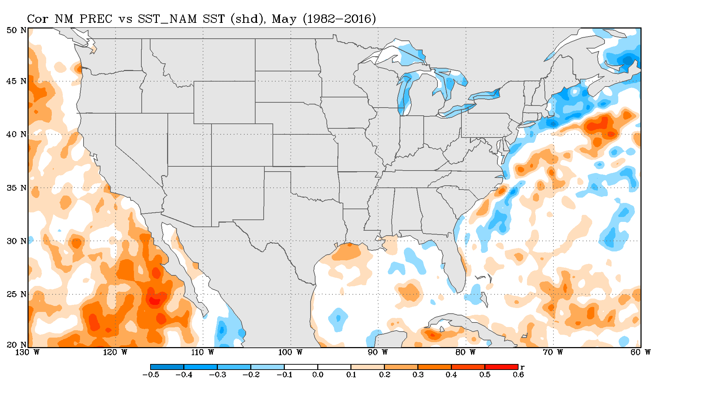
Can we identify moisture sources from precipitation/SST correlations?
AZ/W-NM precip is positively correlated with warm Pacific SSTs and northern GOC SSTs but not GOM
E-NM precip is positively correlated with warm NW GOM (and Pacific SSTs) but not GOC
Positive correlations imply more moisture = more precipitation
●
●

Slide 12
Composite Analysis
What are the factors that cause heavy precipitation in the two regions?
  Identify days of precip > 0.75 in AZ/W-NM &
  > 1 inch in E-NM between July – Sept for 1979-2017
  Average meteorological fields for just those heavy rain days and compare with climatology

Slide 13
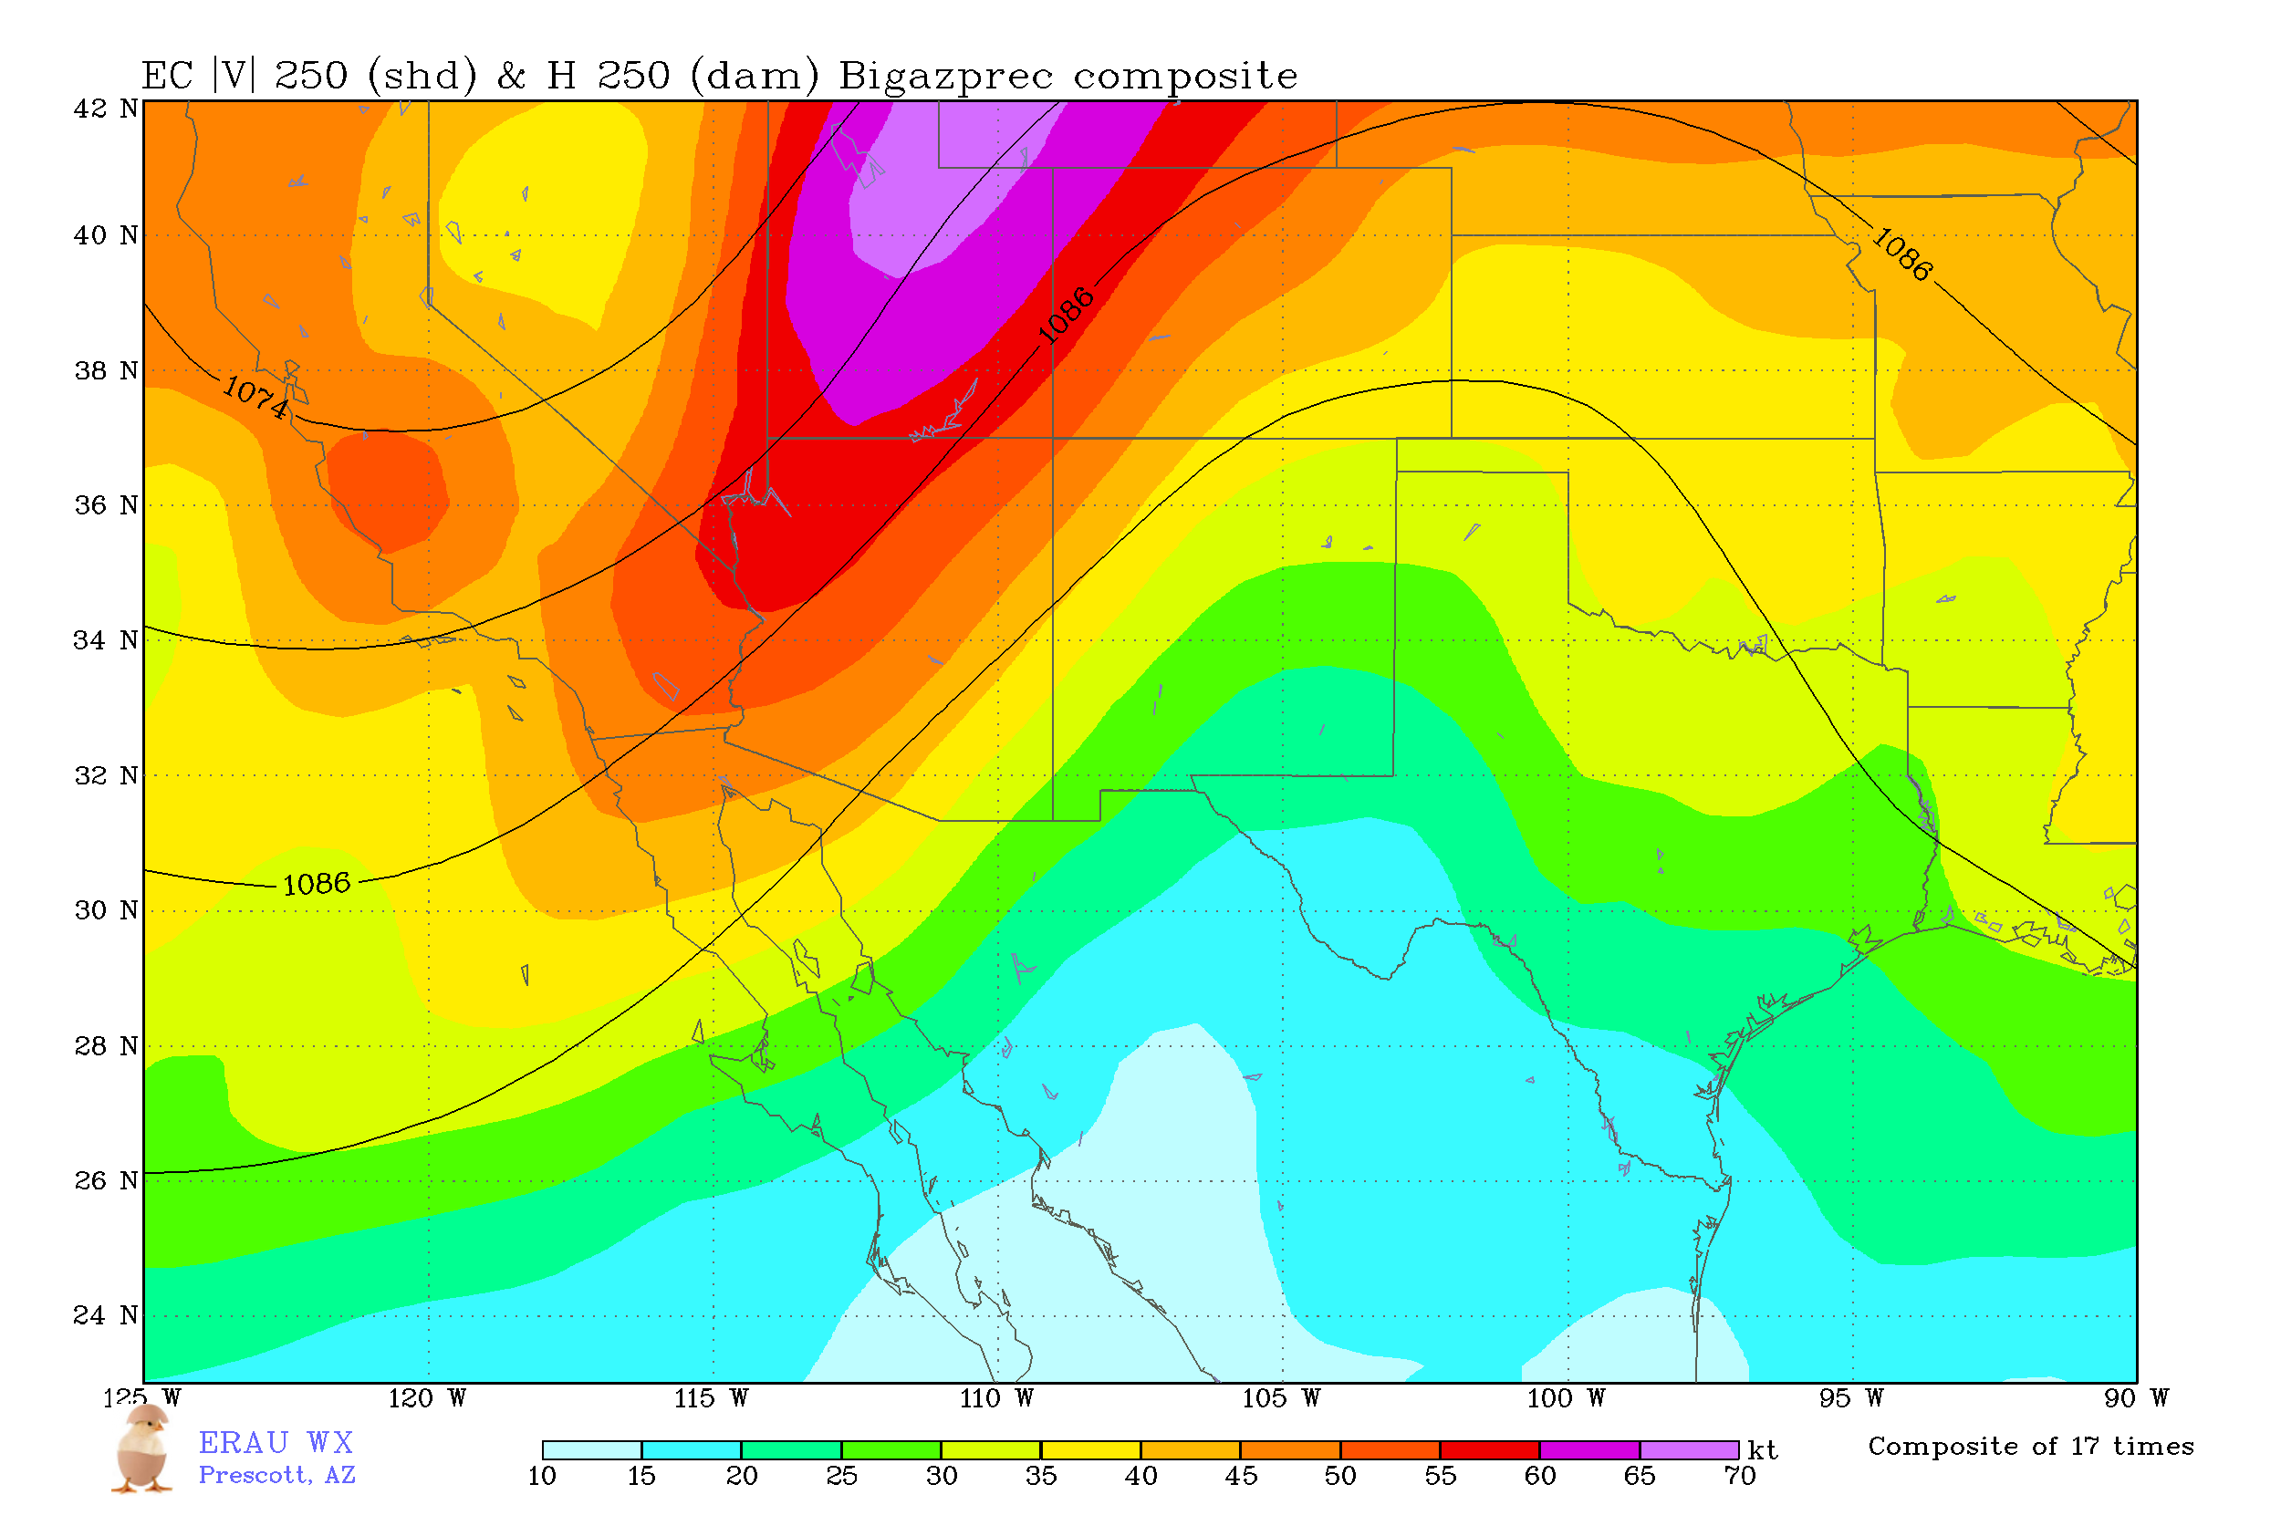
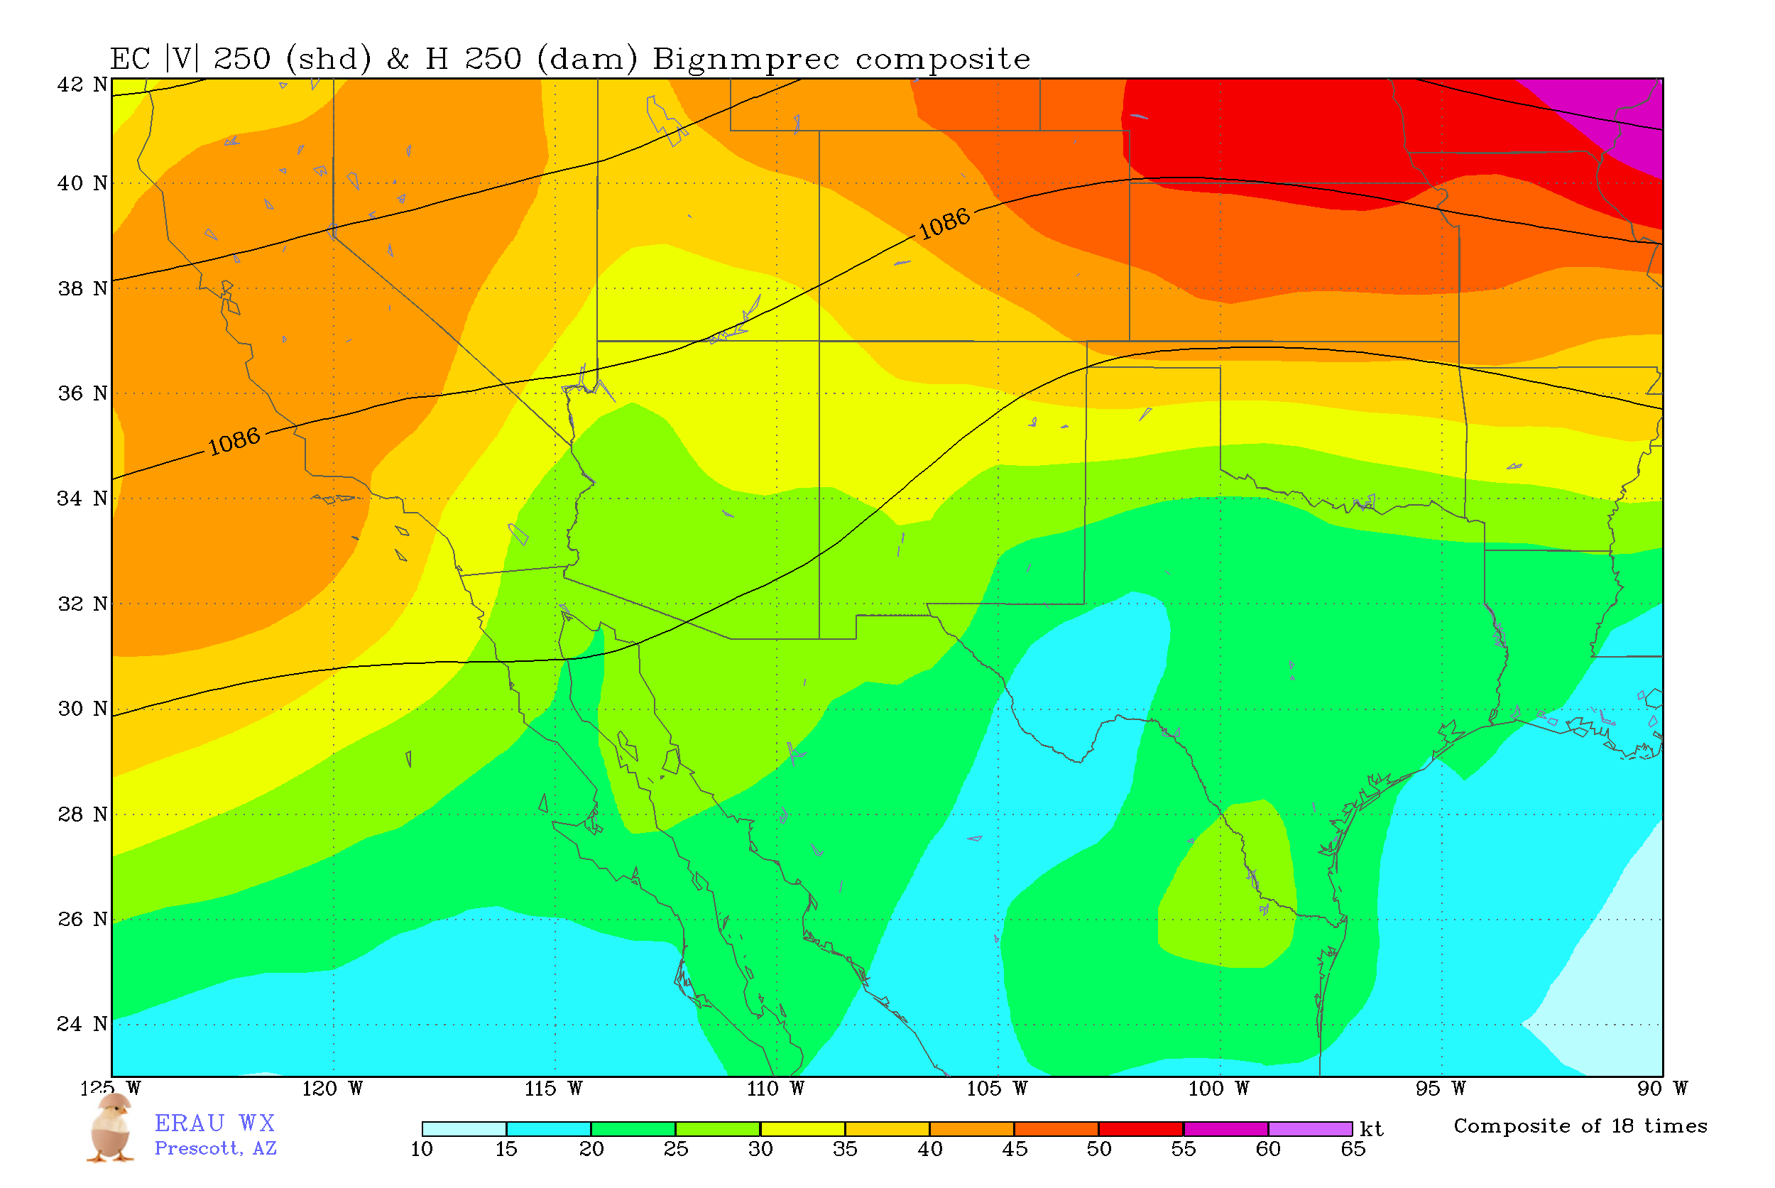
Upper-Level Flow Composites
Composite of AZ/W-NM (Prescott) days > 0.75 inch
Composite of E-NM (Melrose Range) days > 1 inch
Suggests that upper-level forcing important for AZ but not NM

Slide 14
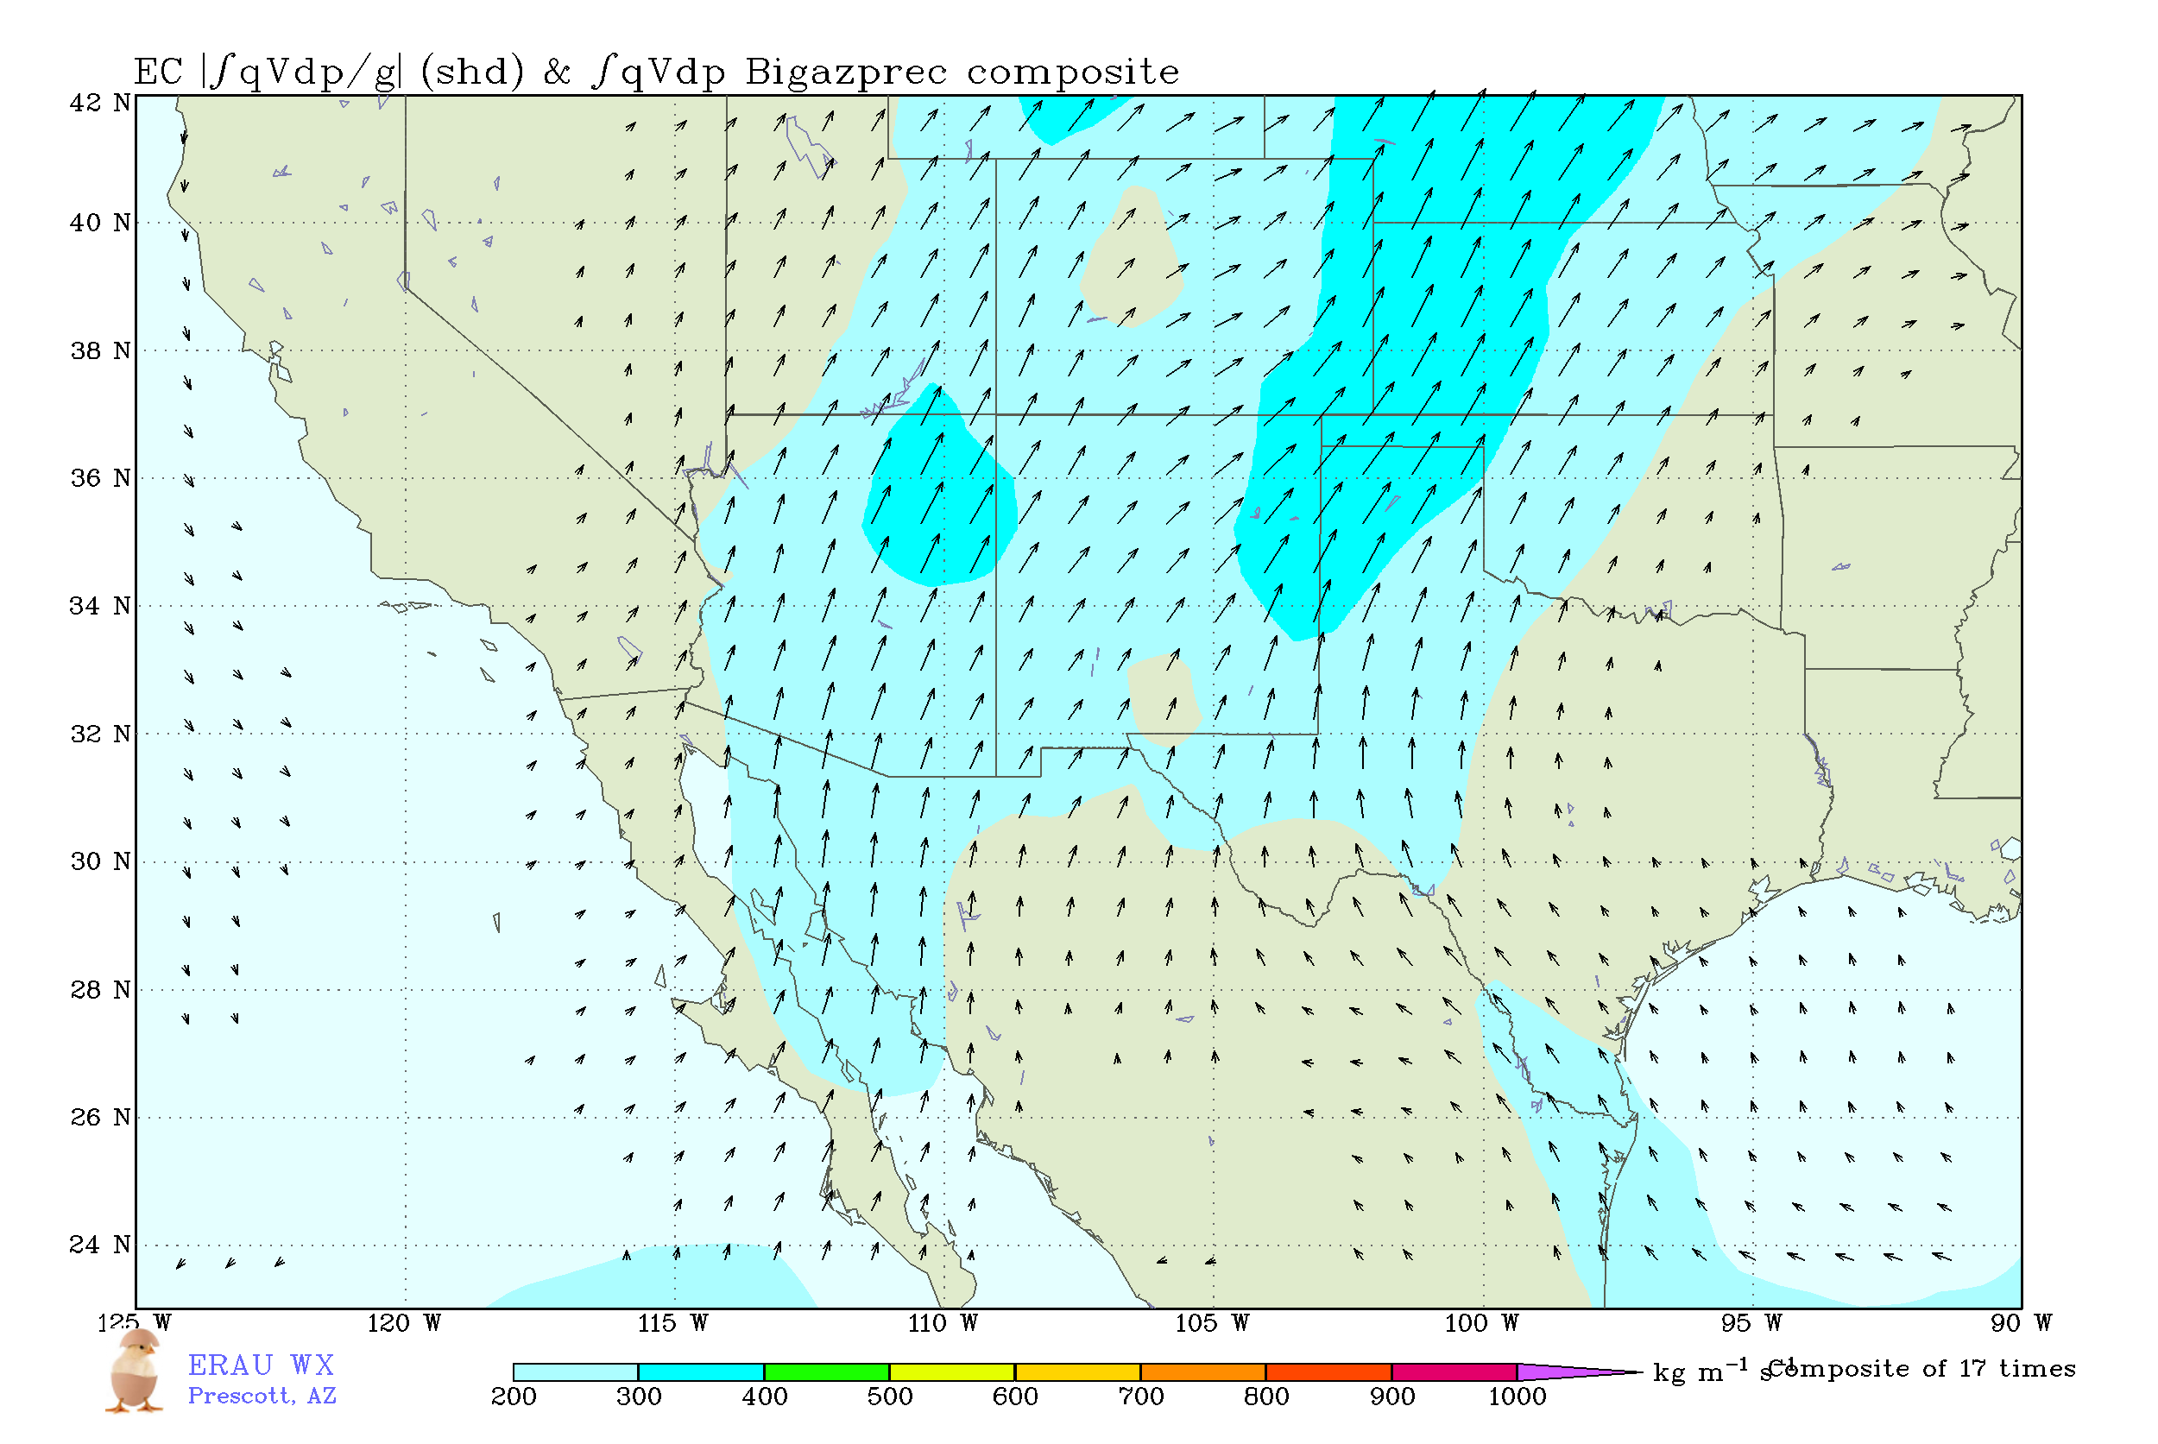
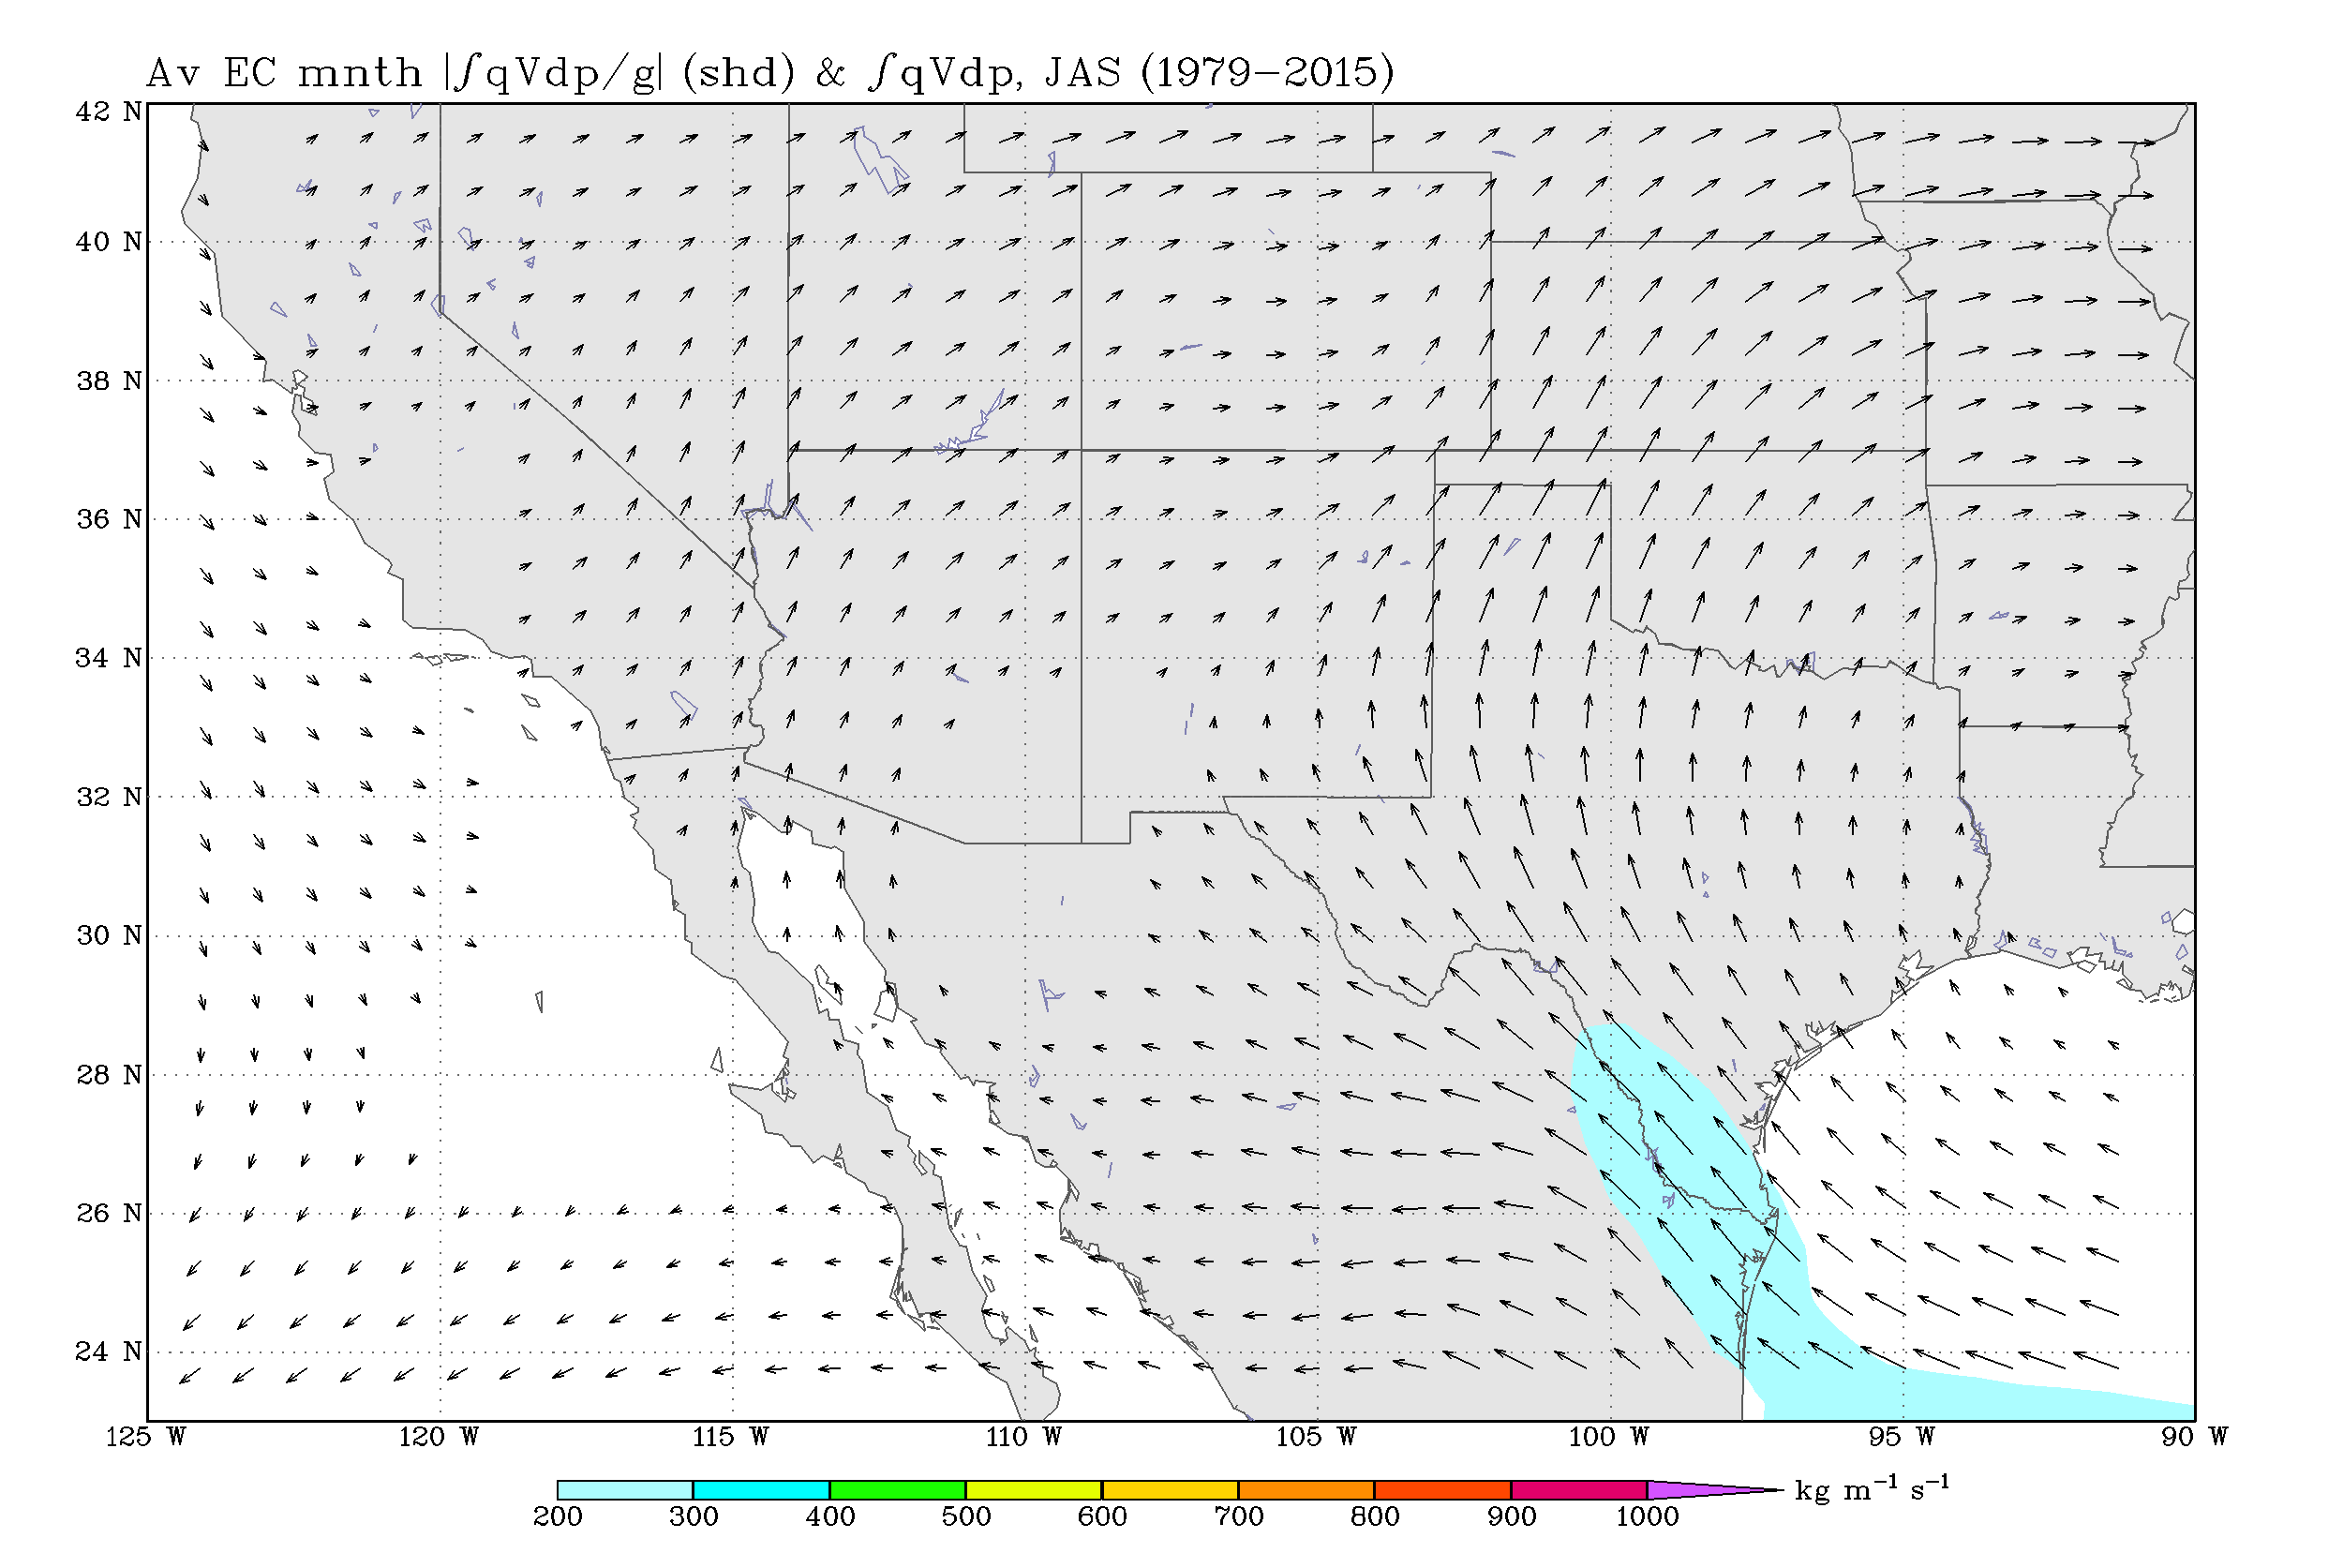
Integrated Vapor Transport (IVT) – AZ/W-NM
Heavy precipitation AZ/W-NM
Climatology

Slide 15
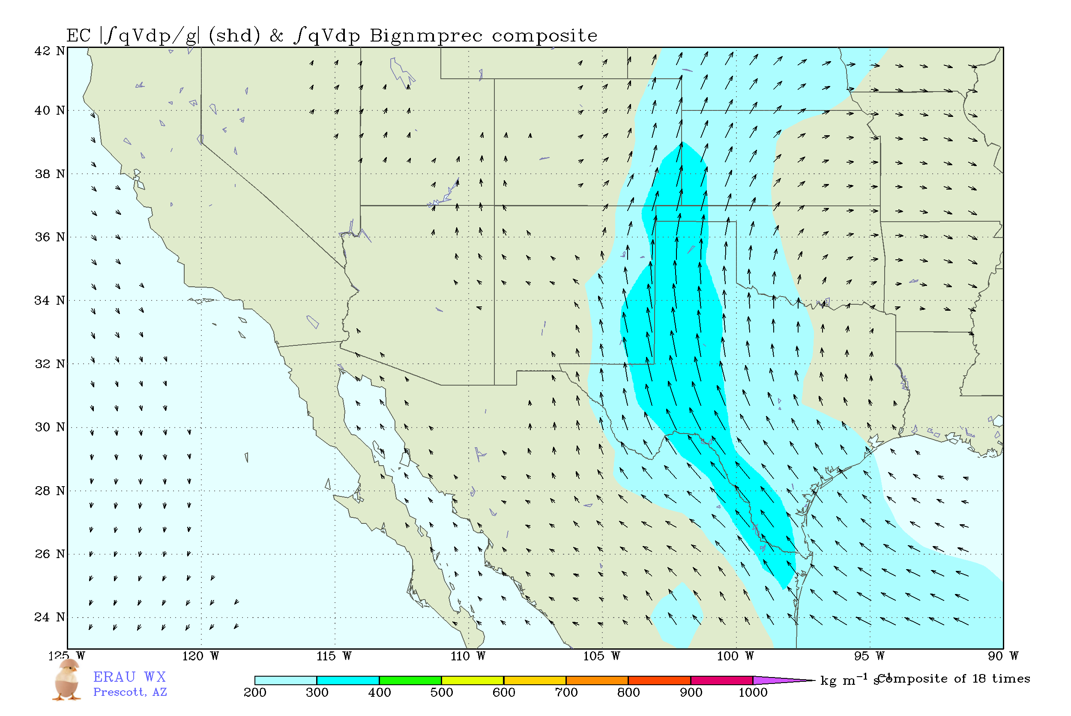
Integrated Vapor Transport (IVT) – E-NM
Heavy precipitation E-NM
Climatology

Slide 16
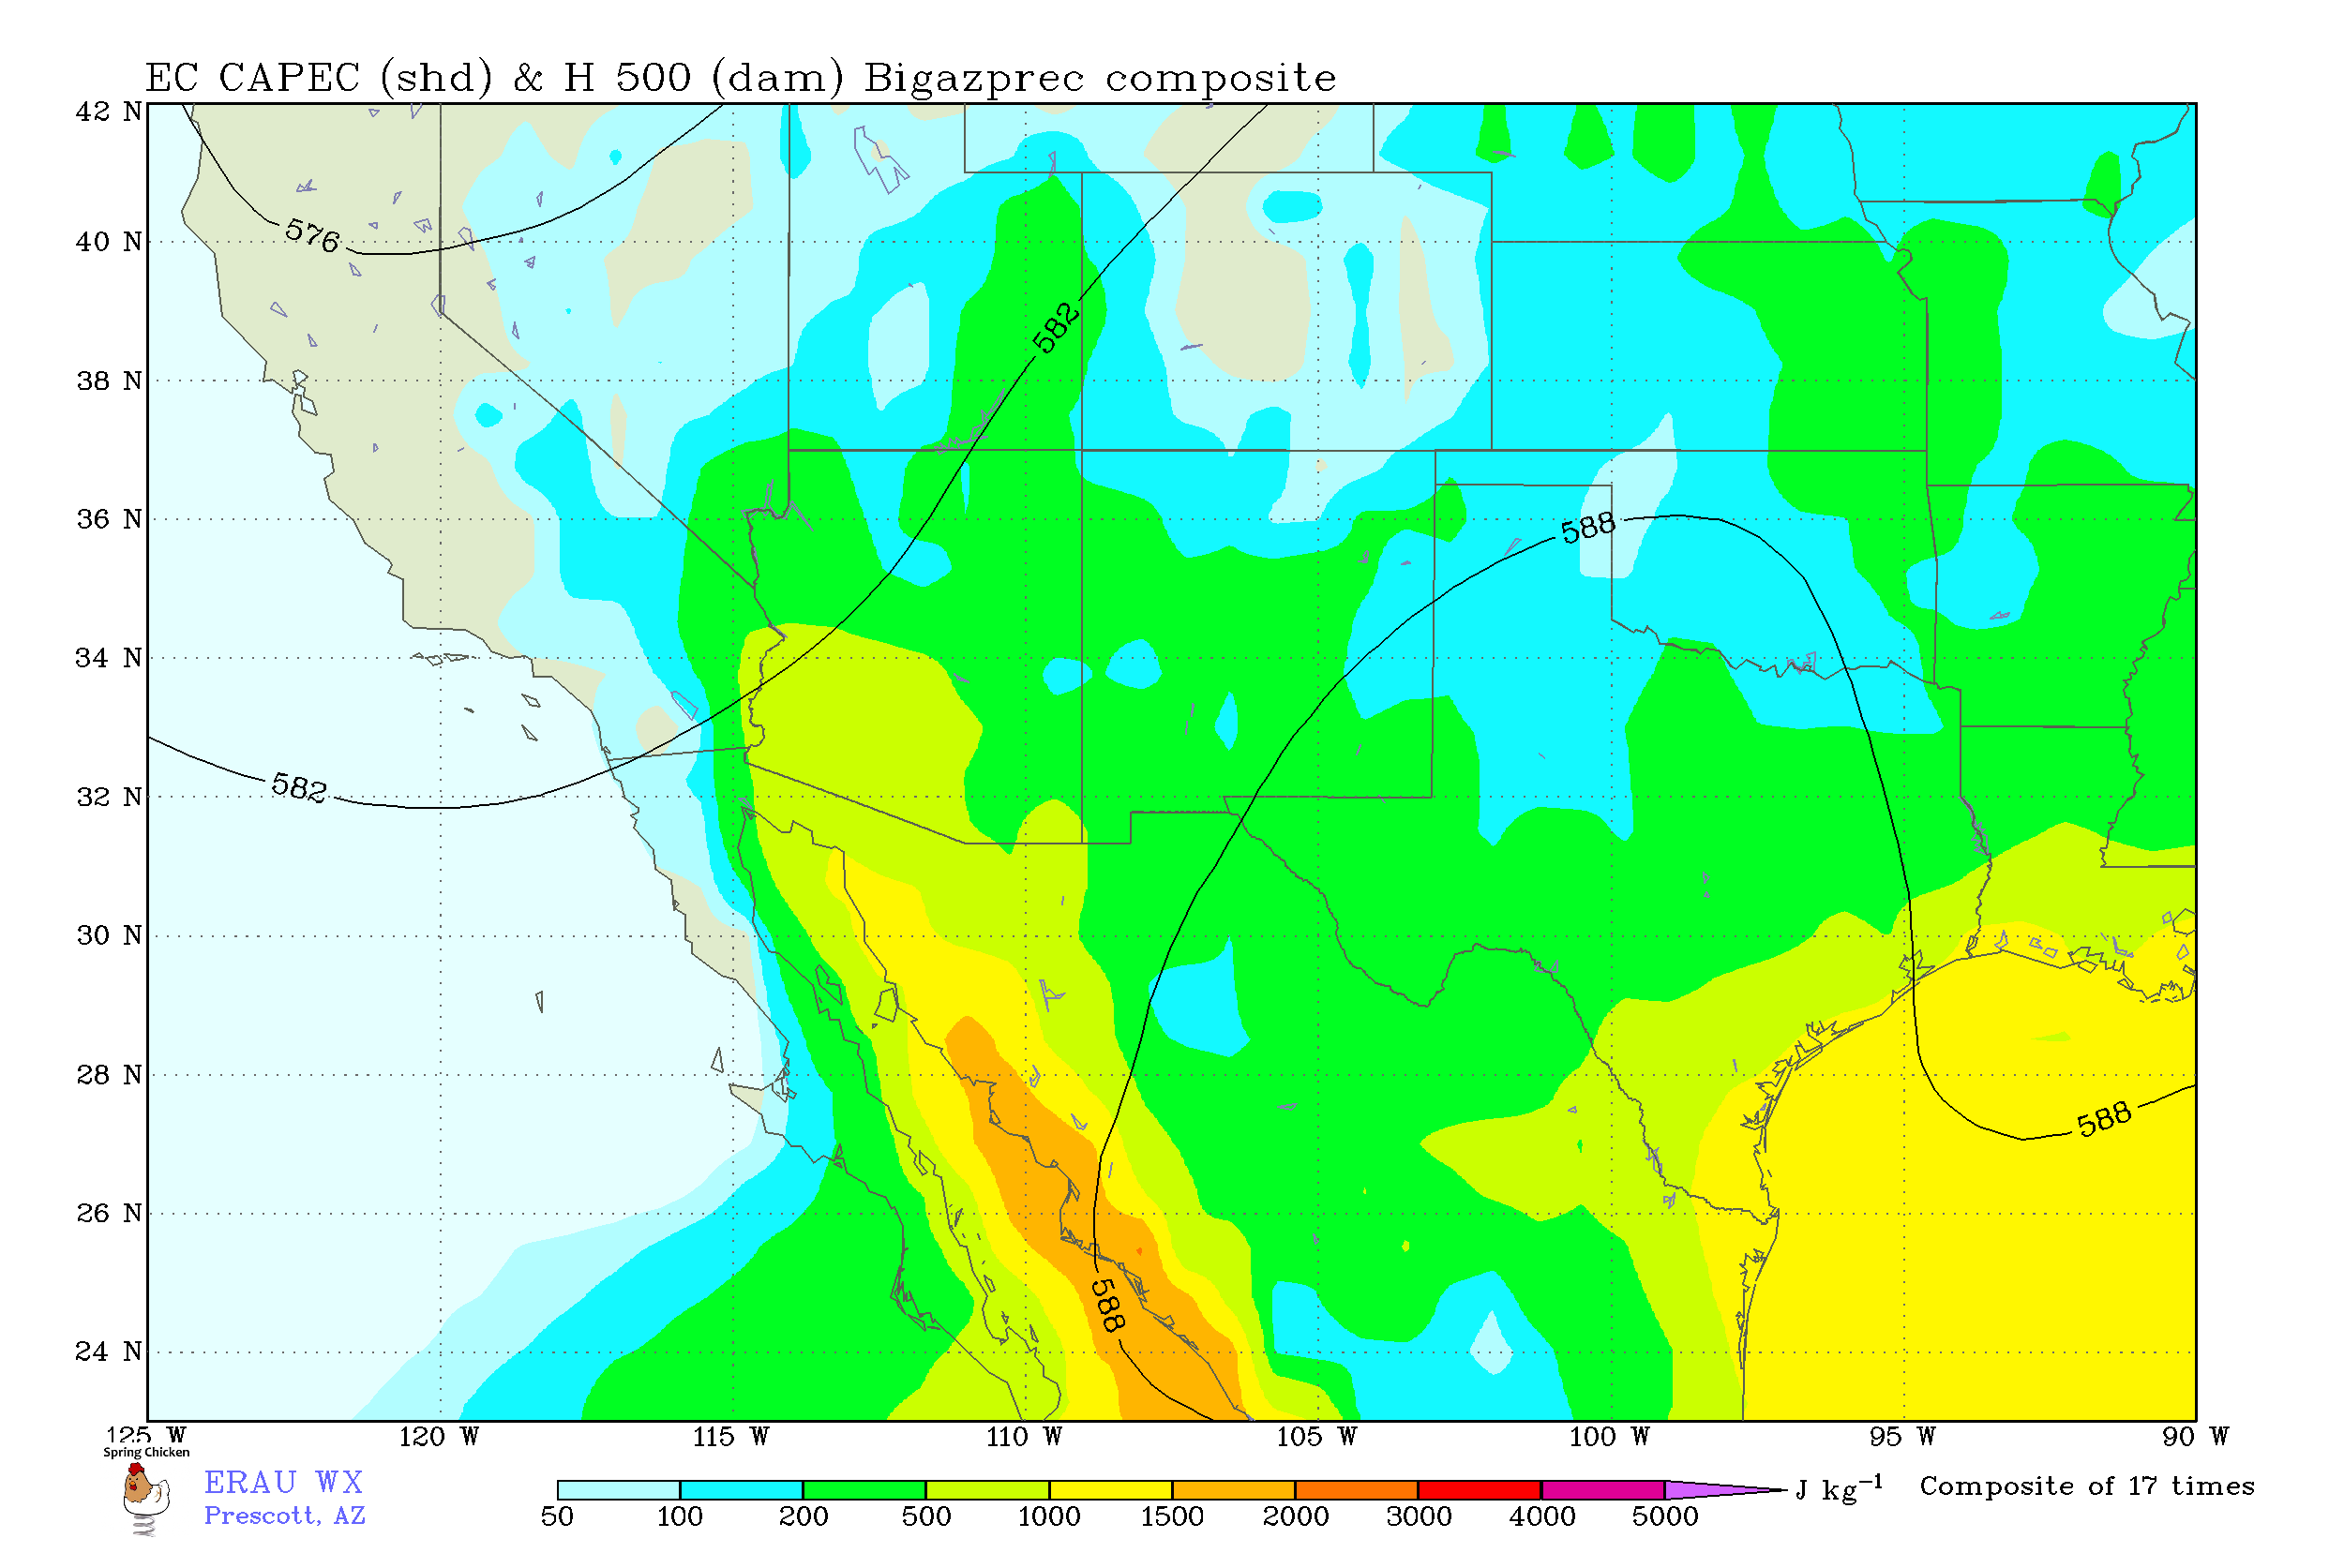
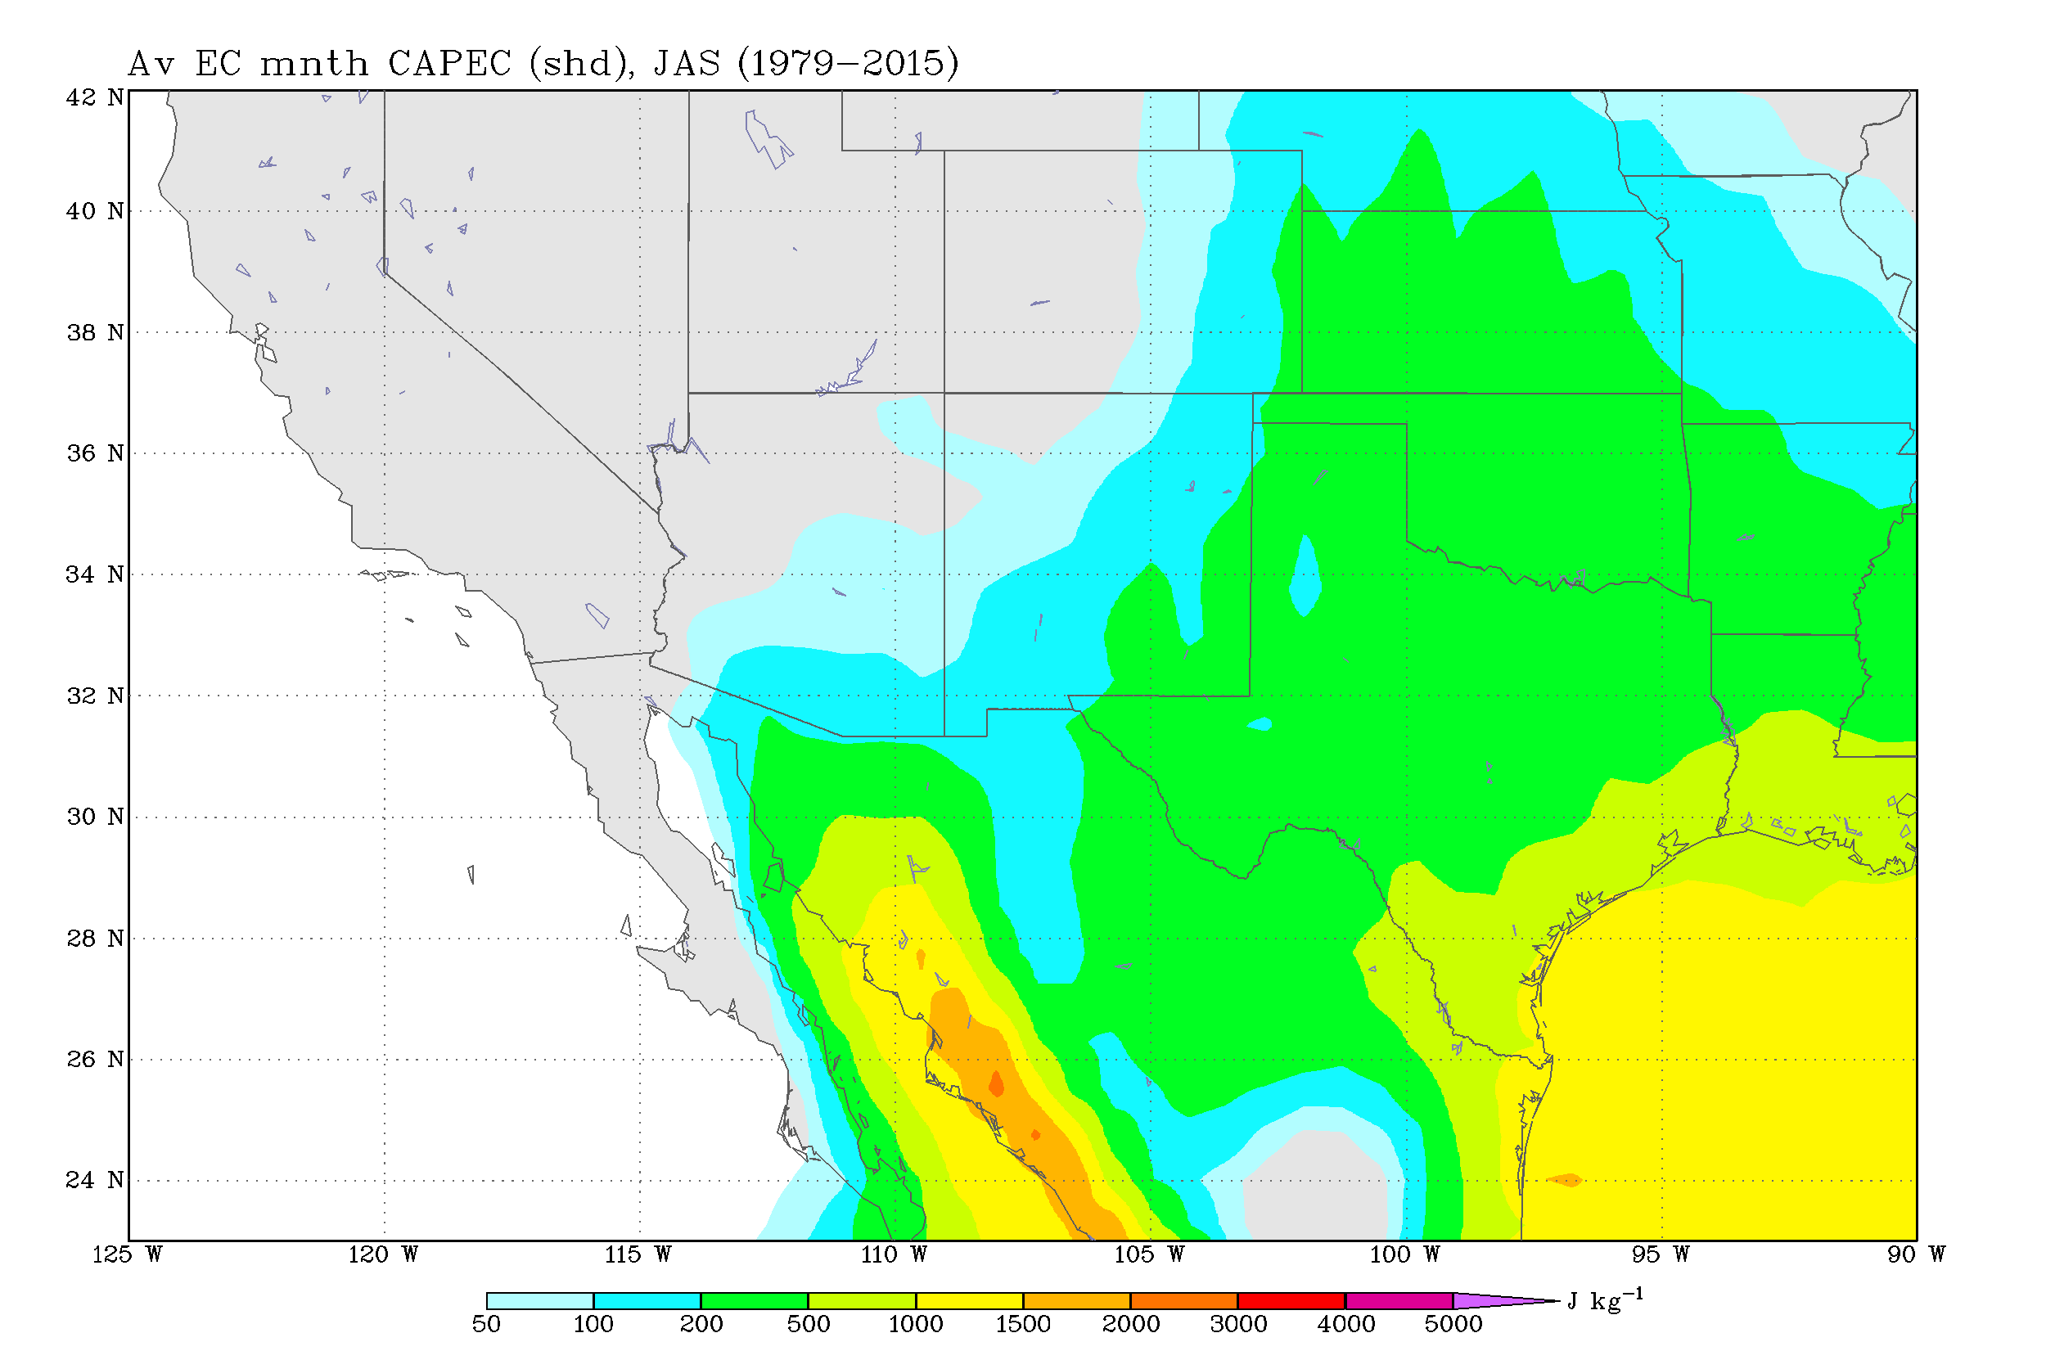
Convective Available Potential Energy (CAPE)
Climatology

Slide 17
Conclusion
E-NM precipitation gets its moisture from the Gulf of Mexico while AZ/W-NM gets its moisture from the Gulf of California
Two annual peaks of precipitation in AZ/W-NM, single summer peak in E-NM
AZ/W-NM precipitation positively correlated with warm E Pacific and Gulf of California SSTs, E-NM precipitation positively correlated with warm E Pacific and Gulf of Mexico SSTs
Gulf of California moisture is blocked from reached E-NM and Gulf of Mexico moisture is blocked from reaching AZ/W-NM, due to mountain ranges in NM
The North American Monsoon is partitioned into AZ/W-NM and E-NM regimes

Slide 18
Acknowledgments
Thank you to Dr. Mark Sinclair for his support, mentorship and guidance throughout this research
Thank you to Dr. Dorothea Ivanova for her support, mentorship and guidance during last year’s research to allow for this continued work
Thank you to NASA Space Grant for funding this research opportunity through Embry-Riddle Aeronautical University, Prescott

Slide 19
References
Climate Prediction Center - Monthly Verifications. https://www.cpc.ncep.noaa.gov/products/predictions/90day/tools/briefing/unger.pri.php. Accessed 2 April 2019
Mazon, J. J., Castro, C. L., Adams, D. K., Chang, H.-I., Carrillo, C. M., & Brost, J. J. (2016). Objective Climatological Analysis of Extreme Weather Events in Arizona during the North American Monsoon. Journal of Applied Meteorology and Climatology, 55(11), 2431–2450. doi:10.1175/jamc-d-16-0075.1
Mitchell, D. L., Ivanova, D., Rabin, R., Brown, T. J., & Redmond, K. (2002). Gulf of California Sea Surface Temperatures and the North American Monsoon: Mechanistic Implications from Observations. Journal of Climate, 15(17), 2261-2281. doi:10.1175/1520-0442(2002)0152.0.co;2
Pines, S. (2017, July 18). Sheriff: 9 killed in flash flooding near Payson. KNXV. https://www.abc15.com/news/region-northern-az/payson/four-confirmed-dead-after-search-and-rescue-operation-at-cold-springs-swimming-hole. Accessed 1 April 2019
Psd. Risk of Seasonal Climate Extremes in the U.S. Related to ENSO. ESRL. https://www.esrl.noaa.gov/psd/enso/climaterisks/. Accessed 2 April 2019

Slide 20
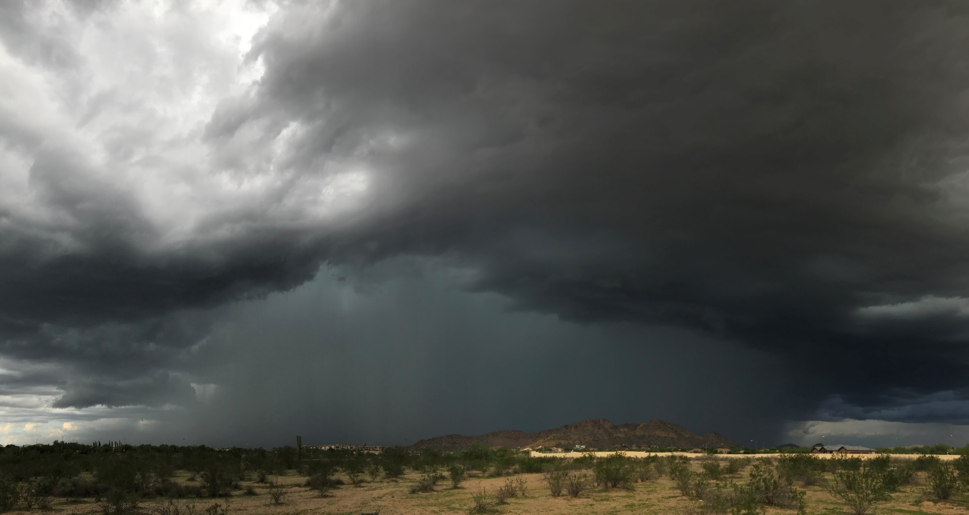
Questions?
Monsoon 2018: Peoria, Arizona

Slide 21
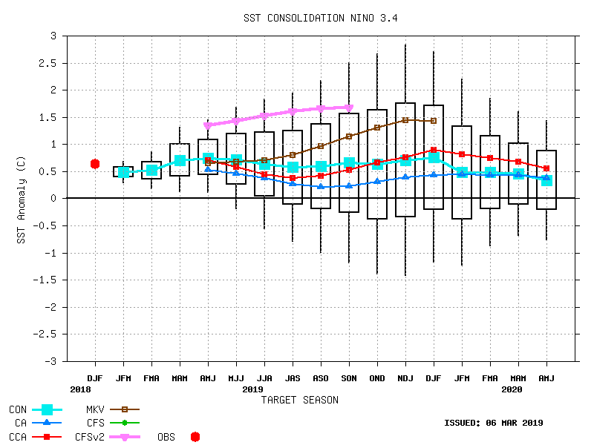
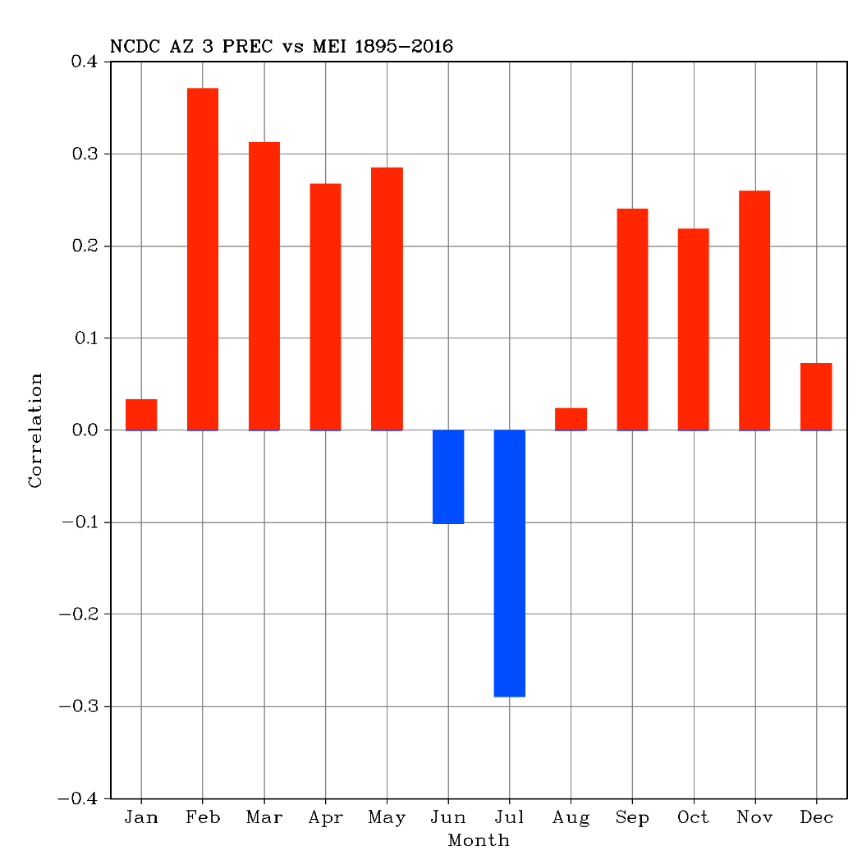
Forecast

Slide 22
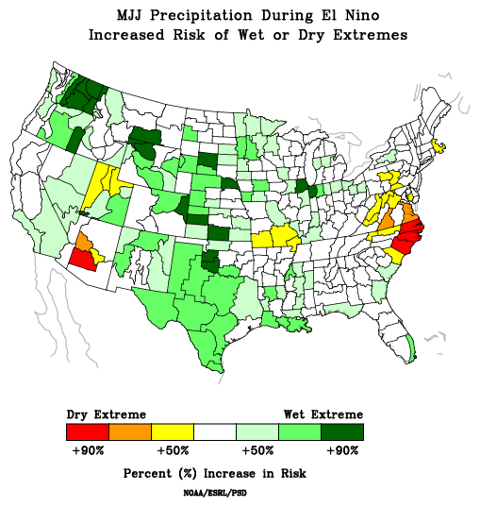
Forecast

